Slide 1
Introduction to Deep Learning

Slide 2
What You Will Learn In This Course
You will learn the distinction between Artificial Intelligence, Machine Learning and Deep Learning historically
You will remember what Machine Learning is, its difference from standard programming and types of ML problems
You will learn what Artificial Neural Networks are and how they work
You will learn the main difference between Deep Learning and Machine Learning, where it is used in our lives and why Deep Learning has become popular
You will learn the technologies used in Deep Learning and the resources you can use while learning these technologies

Slide 3
Fethi Tekyaygil
Github: TekyaygilFethi
Linkedin: fethi-tekyaygil
Twitter: fethidev

Slide 4
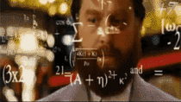
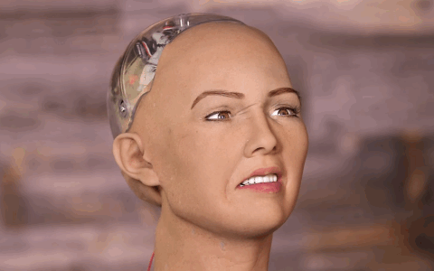
What is Artificial Intelligence?

Slide 5
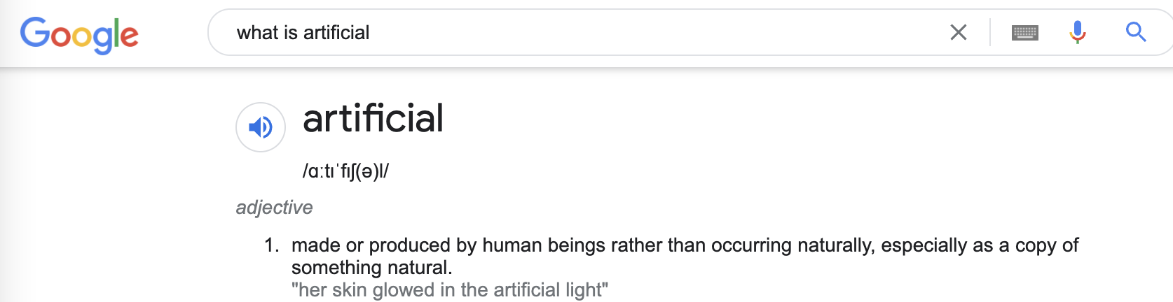
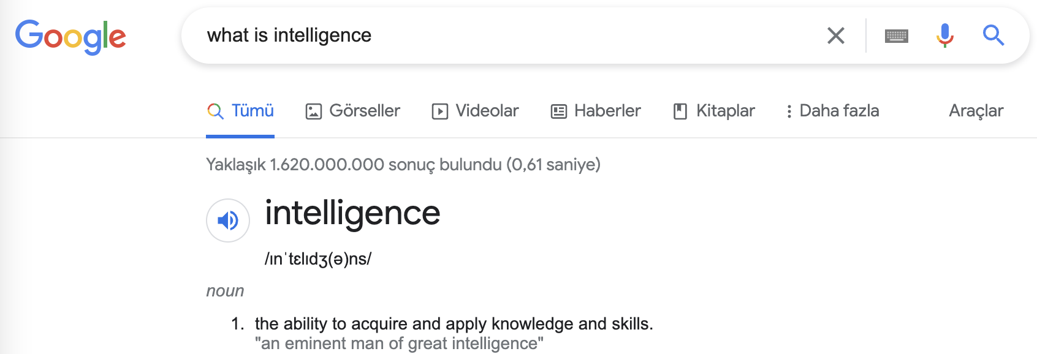
What is Artificial Intelligence?
An artificial being that performs all of the abilities that a human performs by using her/his brain.

Slide 6
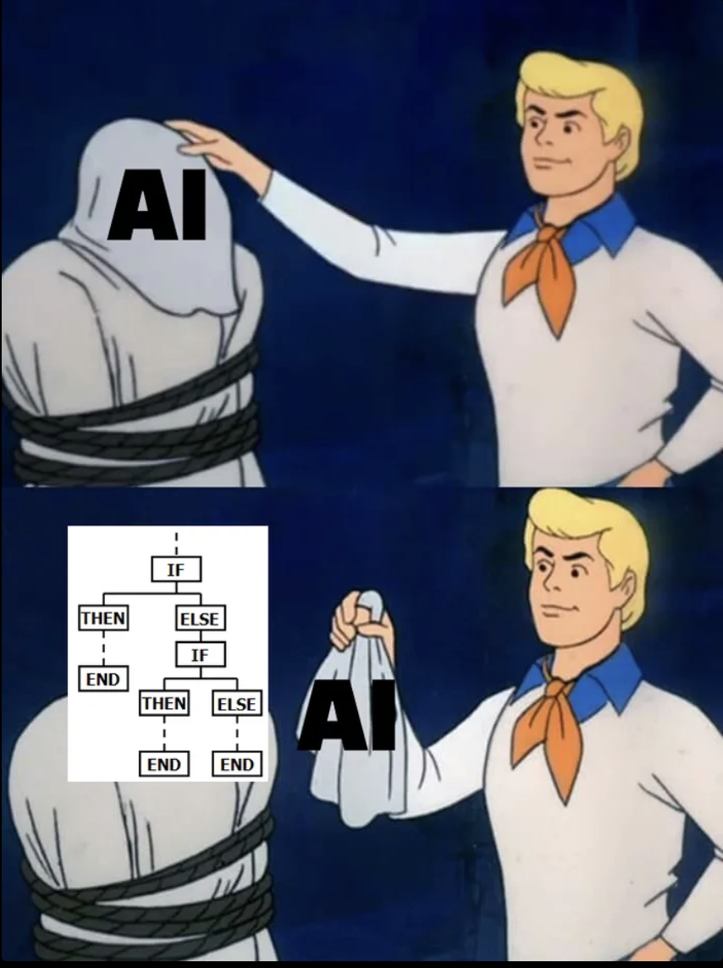
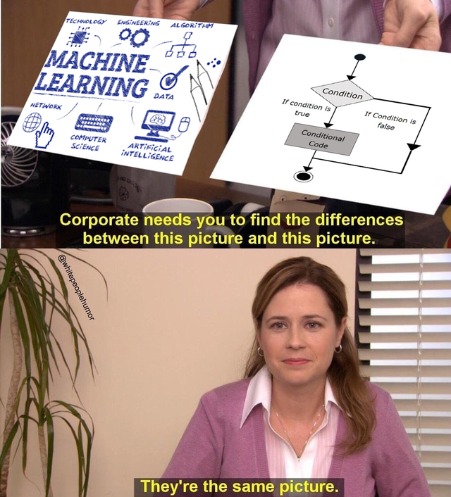
What is Artificial Intelligence?
Artificial Intelligence is a system that learns from the parameters in its environment and, when faced with a situation, can interpret the situation and take action by using its "intelligence" just like a human.
In conventional software languages, this action step is manually coded for each situation.
When a non-coded situation is encountered, the project developed with the conventional programming language gives an error and stops working.

Slide 7
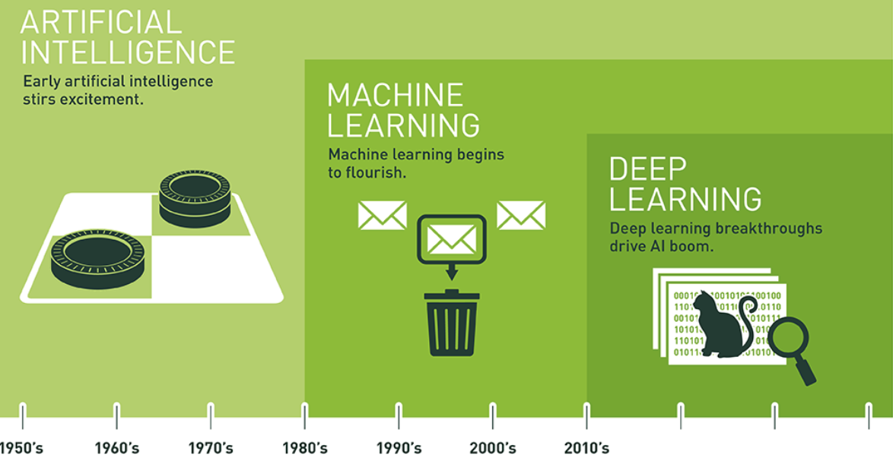
Conceptual Discirimination
Source: https://blogs.nvidia.com/blog/2016/07/29/whats-difference-artificial-intelligence-machine-learning-deep-learning-ai/

Slide 8
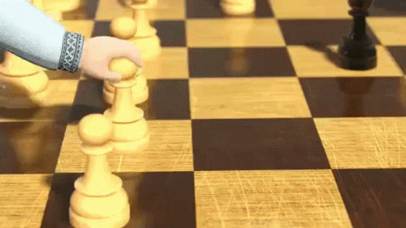
Conceptual Discirimination - Machine Learning
Artificial intelligence was founded in 1956 as an academic discipline. Its purpose was to enable computers to perform tasks that were considered only human-doable tasks.
Over time, they began to describe some problems that is too difficult for Artificial Intelligence.
In the 1980s, a more technical term emerged and became more widely used: Machine Learning.

Slide 9

Conceptual Discirimination - Machine Learning
The reason early researchers found some problems much more difficult is because they were not in line with the techniques used for Artificial Intelligence at the time.
Hard-coded algorithms or fixed, rule-based systems didn't work very well for things like image recognition or inferring meaning from text. It turned out that the solution was not just to mimic human behavior, but to mimic how humans learn.

Slide 10
Conceptual Discirimination - Machine Learning
Machine Learning is a branch of Artificial Intelligence and computer science that focuses on the use of data and algorithms to mimic the way humans learn, increasing its accuracy cumulatively.
As Machine Learning algorithms improved, they became more successful in estimation and classification problems. But some things that humans found easy (like speech or handwriting recognition) were still difficult for machines.

Slide 11
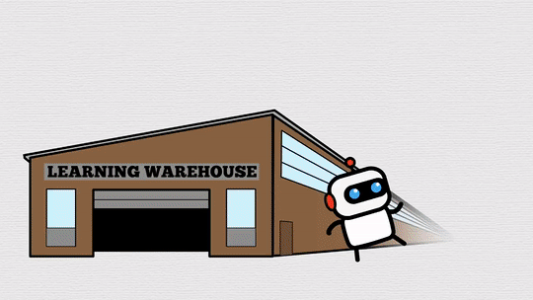
Conceptual Discirimination - Deep Learning
Machine learning stuck with a lot of things elementary school kids easily tackle:
How many dogs are in this picture?
What makes this character in the book cry so much?
It turns out that the problem is not related to the concept of machine learning or the idea of imitating the human brain.

Slide 12
Machine Learning

Slide 13

Machine Learning
Machine Learning is a branch of Artificial Intelligence and Computer Science that focuses on the use of data and algorithms to mimic the way humans learn, increasing its accuracy cumulatively.
Without being explicitly programmed, it learns automatically from experience and uses statistical learning algorithms to create systems capable of improvement.

Slide 14
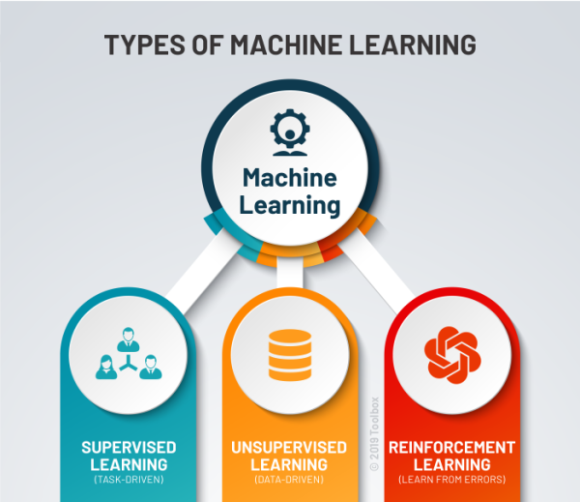
Types of Machine Learning
Supervised Learning: It is the type of training in which labeled data is used to train the model.
Unsupervised Learning: It is the type of training in which unlabeled data is used to train the model.
Reinforcement Learning: A type of training in which a model called an agent is trained to make a series of decisions. The agent learns in an interactive environment through trial and error using feedback returned from the interaction of our given model with the environment.

Slide 15
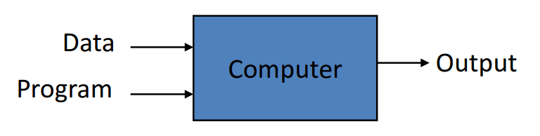
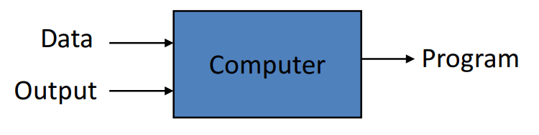
Traditional Programming vs Machine Learning
Traditional Programming:
You give your computer your input data and rules. Input values are processed through these rules and produce an output value.
Machine Learning:
You give your computer your input and output data. The computer determines the rule between these two data for you and your input data passes through these rules in subsequent uses.

Slide 16
Supervised
Learning

Slide 17

Supervised Learning
Supervised Learning; includes machine learning algorithms that process labeled datasets using dependent and independent variables.
The spam filter is a good example of this: The Supervised Learning model is trained with many sample email data with its classes and must learn how to classify new emails as spam or non-spam.

Slide 18
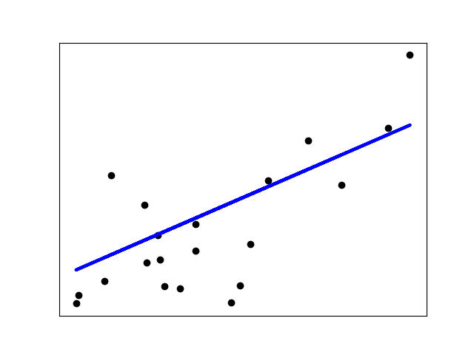
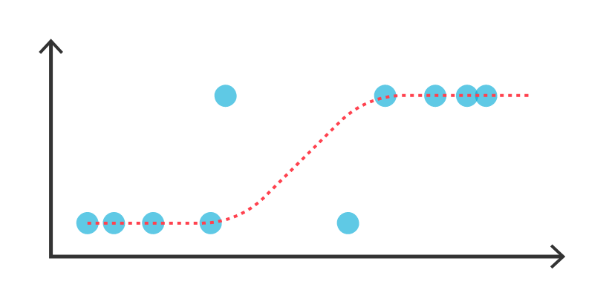
Supervised Learning Algorithms and Architectures
k-Nearest Neighbors
Linear Regression
Logistic Regression
Support Vector Machines (SVMs)
Decision Trees and Random Forests
Neural Networks

Slide 19
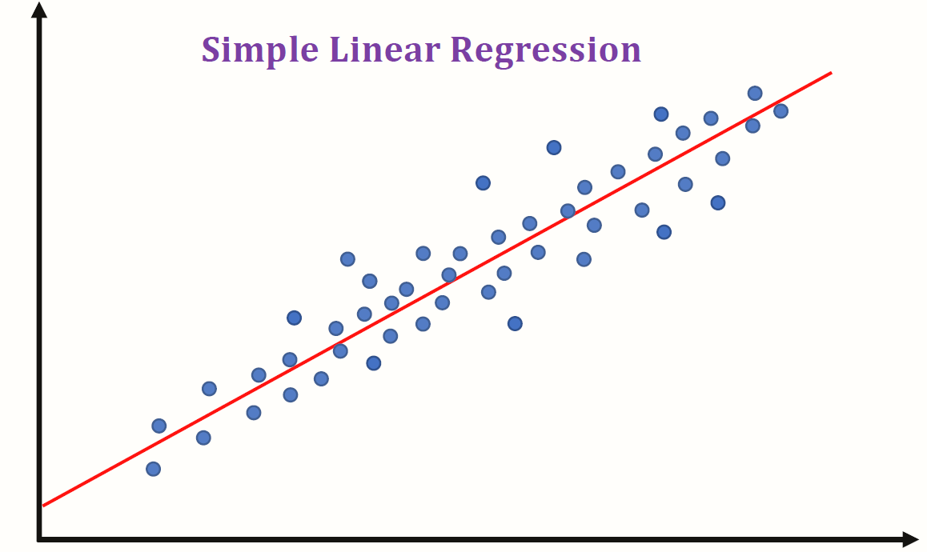
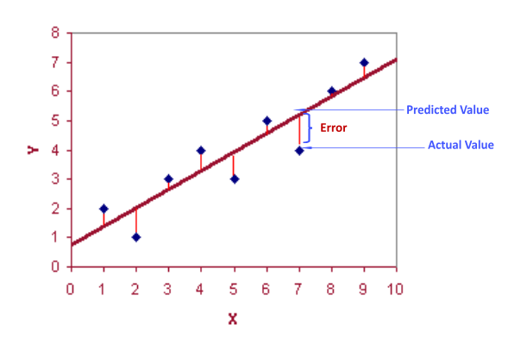
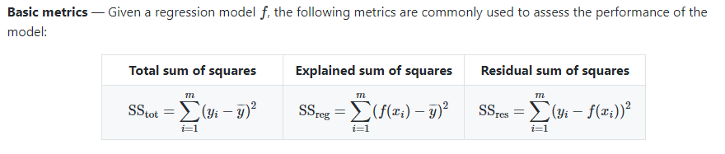
Regression

Slide 20
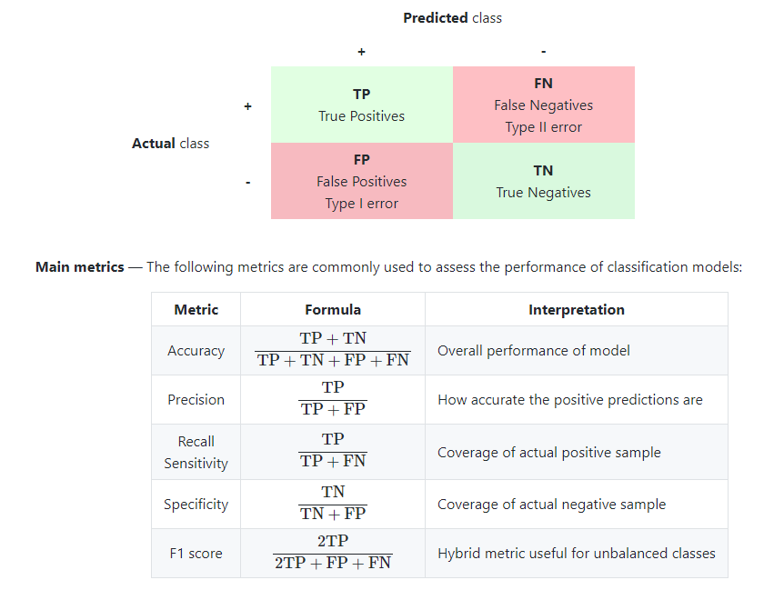
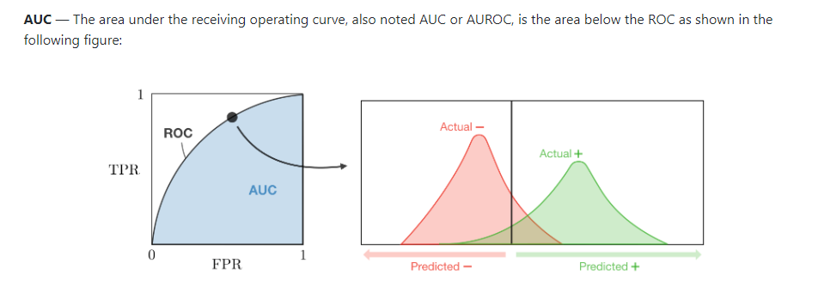
Classification

Slide 21
Real-Life Examples of Problems
Regression;
House price prediction
Age prediciton of a human
Estimation of the diameter of a flower
Estimation of the votes of a candidate for presidential election
Estimation of the engine displacement of the car in L
Classification;
Prediction of whether a person survived the titanic
Prediction of whether a tumor is benign or not
Prediction of whether the student will pass the class or not
Prediction of whether an email is spam or not
Prediction of an object [Dog, cat, bird, horse, automobile, human, car] from a video
Notes:
resim(?)

Slide 22
Unsupervised
Learning

Slide 23
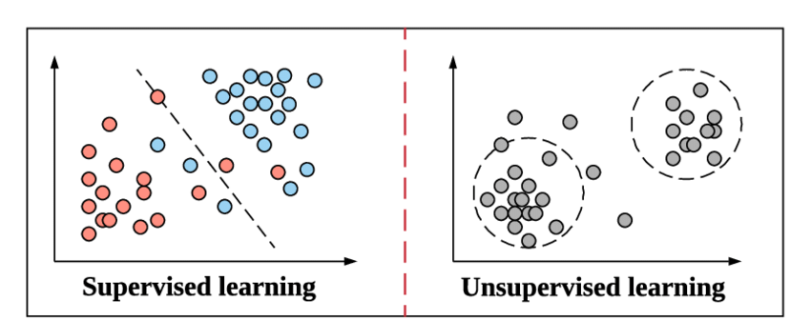
Unsupervised Learning
Unsupervised Learning uses machine learning algorithms to analyze and cluster unlabeled datasets.
These algorithms discover hidden patterns or groupings of data without the need for human intervention.

Slide 24
Why Use Unsupervised Learning?
The most common tasks for Unsupervised Learning are;
Clustering
Density estimation
Representative learning
Unsupervised Learning Algorithms Are Being Used When;
Our cluster number is unknown
We do not have labeled training data
Examples
Security:
Clustering anomaly detection where unusual data points in datasets are identified
Marketing:
Relationship mining, where it finds relationships between data points
Notes:
başlıklar aynı boyutta
temsil öğrenimi[1], bir sistemin ham verilerden özellik tespiti veya sınıflandırma için gereken temsilleri otomatik olarak keşfetmesine olanak tanıyan bir dizi tekniktir.
özellikle dolandırıcılık faaliyeti veya insan hataları veya hatalı ürünler için yararlı bir yetenek
, örneğin perakendecilerin hangi ürünlerin sıklıkla birlikte satın alındığını belirlemek için kullanabileceği bir yetenek.
Müşteri Segmentasyonu
Youtube Video Öneri Sistemi
Grup, Sayfa Önerileri
Reklam Önerme ve Yönlendirme

Slide 25
Unsupervised Learning Algorithms
Clustering
Centroid-based
Density-based Spatial Clustering (DBSCAN)
Hierarchical Cluster Analysis (HCA)
Affinity Propagation
Anomaly Detection and Novelty Detection
One-class SVM
Isolation Forest
Visualization and dimensionality reduction
Principal Component Analysis (PCA)
Kernel PCA
Locally Linear Embedding (LLE)
t-Distributed Stochastic Neighbor Embedding (t-SNE)
Association rule learning
Apriori
Eclat
Notes:
Association rule; birliktelik kuralı
Son olarak, başka bir ortak denetimsiz görev, amacın büyük miktarda veriyi kazmak ve nitelikler arasındaki ilginç ilişkileri keşfetmek olduğu birliktelik kuralı öğrenmesidir.(association rule learning)
ÖRN: mesela alışveriş yapılıyor. merket alışverişinde pazar günü yapılan alışverişlerde ekmek alan kişilerin sucuk ve peynir aldığı da görülüyor. burada bir birliktelik ve buna bağlı bir kümelemeden bahsedebiliriz. buna bağlı pazarlama teknikleri geliştirebiliriz.
ÖRN: barbekü sosu ve patates cipsi satın alan kişilerin biftek satın alma eğiliminde olduğunu ortaya çıkarabilir. Bu nedenle, bu öğeleri birbirine yakın yerleştirmek isteyebilirsiniz.
Visualization and Dimensionality Reduction
Görselleştirme algoritmaları, onlara çok sayıda karmaşık ve etiketlenmemiş veri beslersiniz ve kolayca çizilebilen verilerinizin 2B veya 3B temsilini verirler. Bu algoritmalar, verinin nasıl organize edildiğini anlayabilmeniz ve belki de şüpheli olmayan kalıpları belirleyebilmeniz için mümkün olduğu kadar çok yapıyı korumaya çalışır (örneğin, girdi alanındaki ayrı kümelerin görselleştirmede çakışmasını önlemeye çalışır).
ÖRN: Boyut Azaltma: İlgili bir görev, amacın çok fazla bilgi kaybetmeden verileri basitleştirmek olduğu boyut azaltmadır. Bunu yapmanın bir yolu, birbiriyle ilişkili birkaç özelliği bir araya getirmektir. Örneğin, bir otomobilin kilometresi, yaşıyla güçlü bir şekilde ilişkili olabilir, bu nedenle boyut azaltma algoritması, bunları otomobilin aşınmasını ve yıpranmasını temsil eden tek bir özellikte birleştirecektir. Buna özellik çıkarma denir.
Anomaly Detection:
örneğin, dolandırıcılığı önlemek için olağandışı kredi kartı işlemlerini tespit etmek, üretim hatalarını yakalamak veya bir veri kümesini başka bir öğrenme algoritmasına beslemeden önce aykırı değerleri otomatik olarak kaldırmak.()

Slide 26
Deep
Learning

Slide 27


Deep Learning
Deep Learning is a subfield of machine learning related to algorithms called neural networks.
Simply put, deep learning tries to learn from data using neural networks with more neurons, layers, and interconnections.

Slide 28
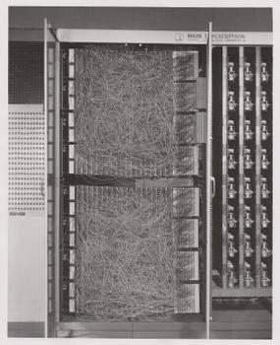
Historical Development of Deep Learning
1. Wave - Cybernetics (1940-1960):
Beginning with McCulloch-Pitts' development of the neuron in the network as an attempt to imitate the biological neuron, Cybernetics is the earliest predecessor of modern Deep Learning, based on the idea of how the human brain learns.
This model, whose output is linear, was taking various inputs and weight values given by a human for each input. This model was only outputting True/False based on input and weights.
In the late 1950s, the American psychologist Frank Rosenblatt developed the Perceptron, which would automatically learn weight values.
Notes:
Bu alanda yapılan ilerlemeler, gerçek beyinler gibi öğrenmeye başlayacak ve bazı girdiler verildiğinde sonuçlar sağlayacak sistemler oluşturmaya yardımcı olacak daha basit bir hesaplama modelinde tekrarlama hedefine dayanıyordu.
Perceptron o zamanlar için dikkate değer bir makine olmasına rağmen, o zaman yerine getirilemeyecek cesur iddialarda bulundu.
Bu Lineer modellerin çeşitli sınırlamaları olması nedeniyle araştırma bir süreliğine durdu.
Sınırlamalardan en önemlilerinden biri, bu lineer modellerin XOR işlevleri için eğitilememesiydi.

Slide 29
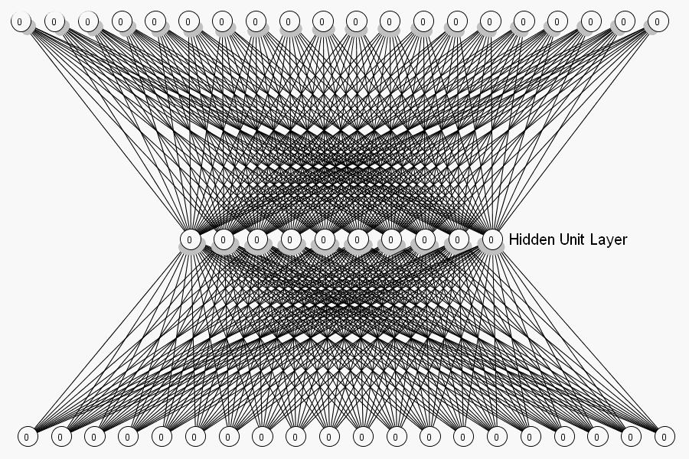
Historical Development of Deep Learning
2. Wave - Connectionism (1980-1990):
This approach is inspired by the cognitive sciences.
The concept of Artificial Neural Network (ANN) was introduced at this time. The main idea behind ANNs was to develop a network of individual units that can be programmed to achieve intelligent behavior.
With this concept, the concept of hidden layers was introduced for the first time.
But in the mid-1990s, startups based on AI started making unrealistic claims, so investors backed off. For this reason, applications were very few until the beginning of the 2000s.
Notes:
Bunun yanı sıra LSTM, dağıtılmış temsil ve işleme, derin sinir ağlarını eğitmek için back-propagation gibi çeşitli modeller geliştirildi.

Slide 30
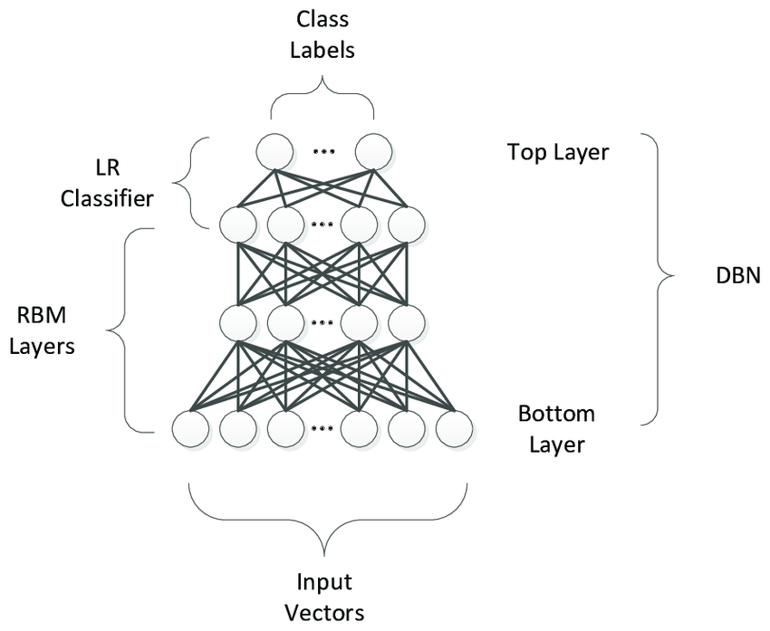
Derin Öğrenme’nin Tarihsel Gelişimi
3. Deep Learning (2006-):
In 2006, Geoffrey Hinton trained the Deep Belief Network.
The advances provided by Geoffrey Hinton have been used by other researchers to train different types of Deep Webs. This enabled researchers around the world to train more complex neural networks and led to the popularization of the term Deep Learning.

Slide 31

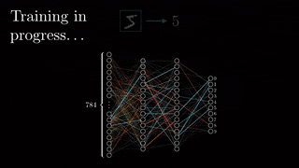
Artificial Neural Networks
Neural networks are information processing systems with interconnected neurons. Using certain algorithms, they can recognize, cluster, and classify hidden patterns and correlations in raw data and continually learn and improve – over time.

Slide 32
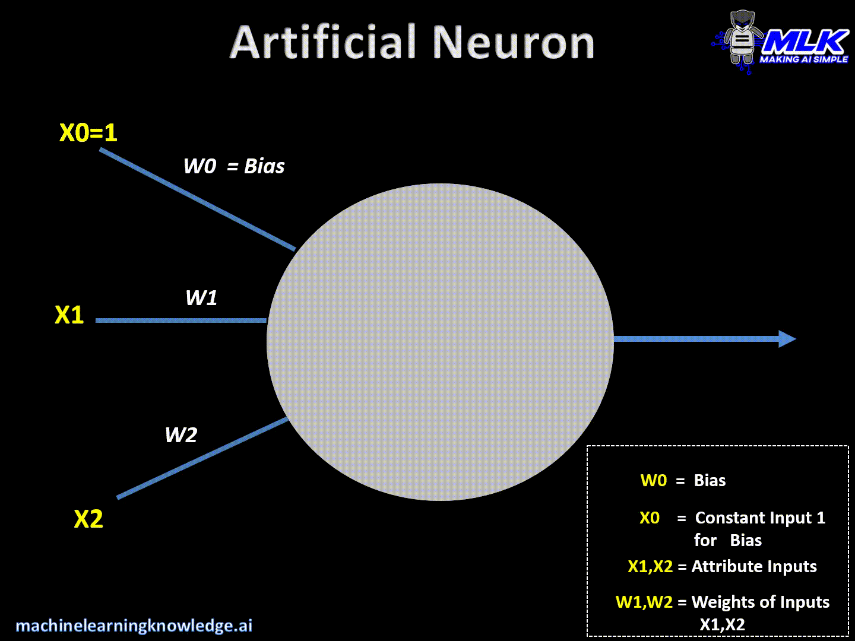
How Artificial Neural Networks Works?
The output from each neuron transmits data to the next layer in the network. This causes the output of one node to be the input of the next node. The process of passing data from one layer to the next is called a feed-forward operation.
In a neural network, we update the weights of neurons based on the error in the output. This process is known as back propagation. Activation functions enable backpropagation as gradients are provided with error to update weights and deviations.
Notes:
Her bir nöron; input, weight, bias ve bir outputtan oluşan kendi doğrusal regresyon modeli olarak düşünülebilir.
Ağırlıklar ilk başta rastgele olarak atanır. Tüm inputlar daha sonra ilgili ağırlıklarıyla çarpılır ve ardından toplanır. Daha sonra çıktı, çıktıyı belirleyen bir aktivasyon fonksiyonundan geçirilir.

Slide 33
Uses of Deep Learning In Real World

Slide 34
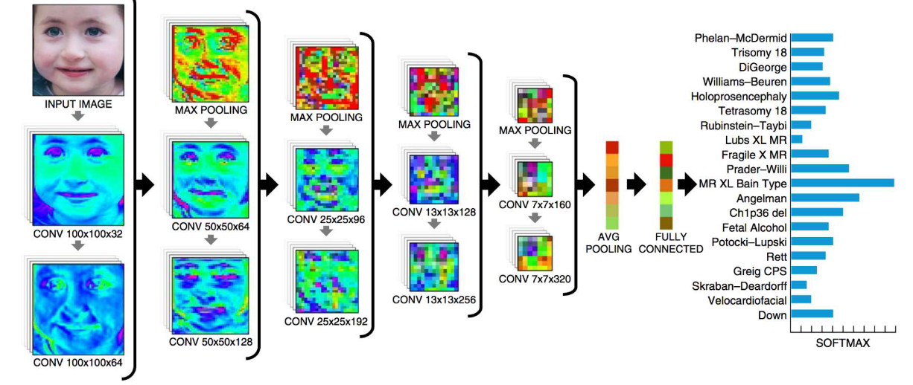
Genetic Disorder Detection
Realization of race, nationality, genetic disorder detection from the face shape of people

Slide 35

Image Classification
Categorizing an image to pre-defined class according to its content

Slide 36
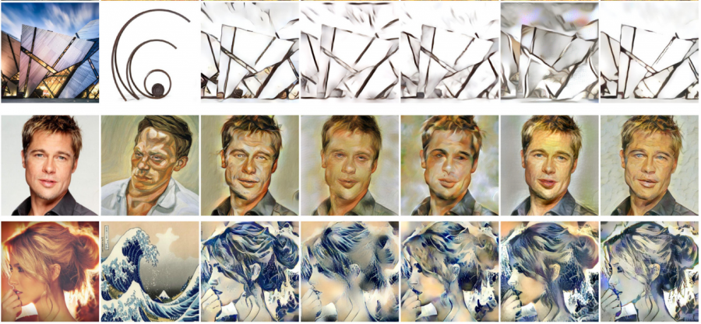
Artistic Style Transfer
Blending two images with each other in order to create a new image

Slide 37
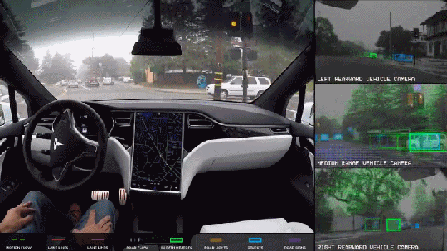
Autonomous Vehicles - Tesla
Detecting the environment of autonomous vehicles and shaping the decision-making mechanism according to the perceived
Tesla's competitive advantage is that they collectively source all their data from the hundreds of thousands of Tesla vehicles currently on the road
This approach of Tesla is called imitation learning. It learns algorithms from the decisions, reactions and actions of millions of real drivers around the world

Slide 38
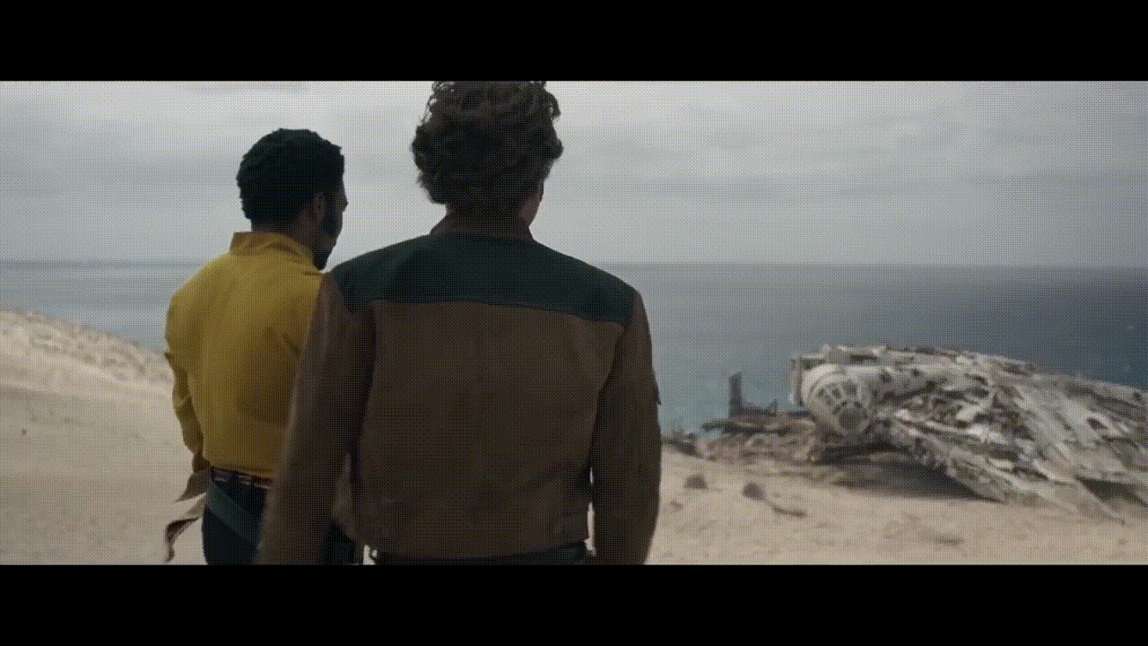

DeepFake
Replacing a person in an existing image or video with another person's image using artificial neural networks with DeepFake

Slide 39
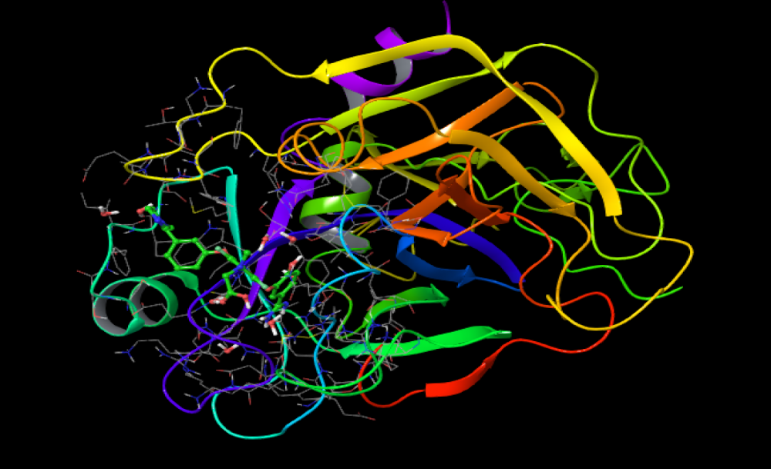
Discovery of Compatible Molecules and Proteins for Pharmaceutical Manufacturing
Discovery of proteins and molecules that are compatible with each other and can come together in order to control the effect and quality of drugs to be produced for use in disease treatments, as well as their effects on health.

Slide 40
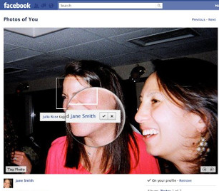
Face Recognition for Photo Tagging - Facebook
Suggesting tagging by identifying the people in your photos

Slide 41
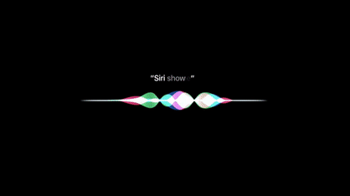
Voice Assistant - Siri (Apple)
Communicating with the user by voice and responding to verbal commands

Slide 42
Why Deep Learning Has Become Popular?

Slide 43
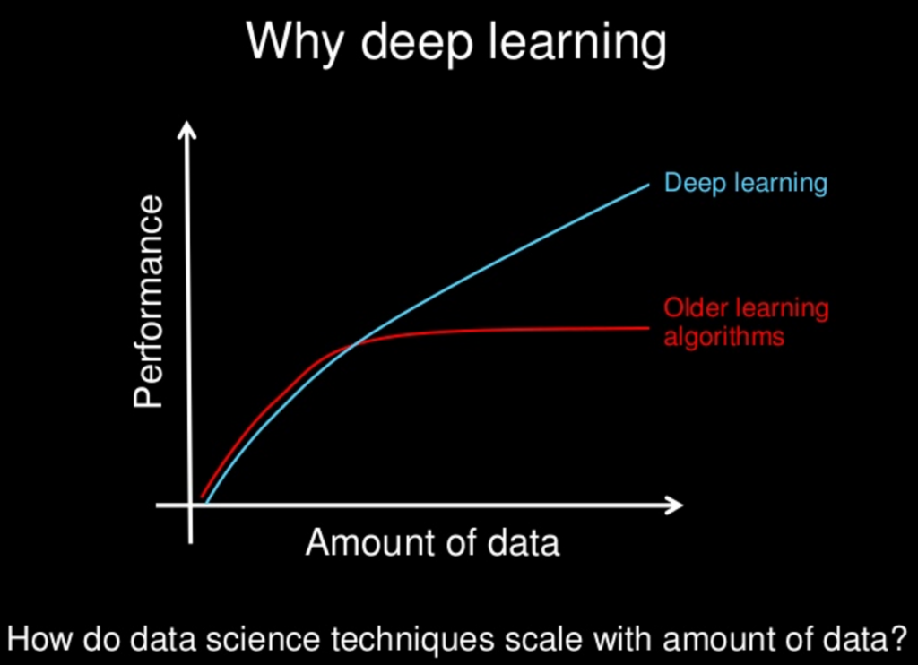
Why Deep Learning Has Become Popular?
Data Dependency: The key difference between deep learning and traditional machine learning is their performance, which changes as data scales up.
When the data is small, deep learning algorithms do not perform as well. This is because deep learning algorithms need large amounts of data to understand it perfectly.
On the other hand, in traditional machine learning, excess data can lead to overfit. (Noisy data)

Slide 44
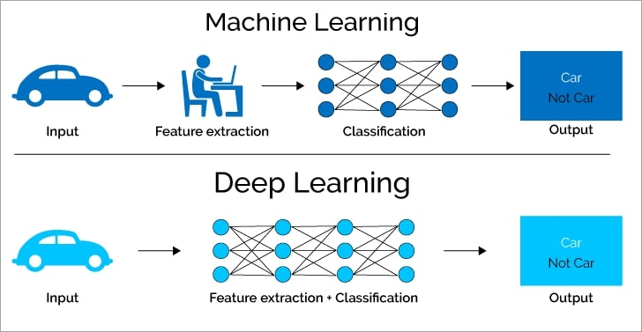
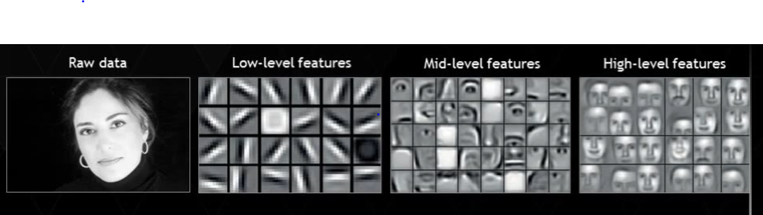
Why Deep Learning Has Become Popular?
Feature Engineering: In Machine Learning, most of the features need to be defined by an expert and then manually coded by domain and data type. (For example, a doctor is more likely to label the values of a tumor)
Deep learning algorithms will try to learn high-level features from the data, thus reducing the task of engineering new features for each problem.
Notes:
Feature engineering is a process of putting domain knowledge into the creation of feature extractors to reduce the complexity of the data and make patterns more visible to learning algorithms to work. This process is difficult and expensive in terms of time and expertise.
Bahsi geçen featurelar piksel değerleri, şekil, dokular, konum ve yön olabilir. Makine Öğrenimi algoritmasının çoğunun performansı, özelliklerin ne kadar doğru tanımlandığına ve ayıklandığına bağlıdır.
. Örneğin, CNN mimarisinde, erken katmanlardaki kenarlar ve çizgiler gibi düşük seviyeli özellikleri, ardından insanların yüzlerinin bölümlerini ve daha sonra bir yüzün üst düzey temsilini öğrenmeye çalışacaktır.

Slide 45
Why Deep Learning Has Become Popular?
Problem Solving Approach: When solving a problem using traditional machine learning algorithm, it is usually used to break the problem into different parts, solve them one by one, and combine them to get the result. (Divide and Conquer) Deep learning, by contrast, advocates solving the problem end-to-end.
Problem: Detecting what and where multiple objects are.
ML approach: The problem is divided into two steps, object detection and object recognition. The image is reviewed and all possible objects are found then object recognition algorithms are used to identify all objects.
DL approach: The process is done end-to-end, in the output of the image given to an artificial neural network, the location is obtained along with the object name.
Notes:
Birden çok nesnenin ne olduğunu ve nerede bulunduğunu algılamanız gereken bir sorununuz olduğunu
Tipik bir makine öğrenimi yaklaşımında, sorunu nesne algılama ve nesne tanıma olmak üzere iki adıma bölersiniz. İlk olarak, görüntüyü gözden geçirmek ve olası tüm nesneleri bulmak için kapmak gibi bir sınırlayıcı kutu algılama algoritması kullanırsınız. Ardından, tanınan tüm nesnelerden, ilgili nesneleri tanımak için HOG'lu SVM gibi nesne tanıma algoritmasını kullanırsınız.
Aksine, derin öğrenme yaklaşımında işlemi uçtan uca yaparsınız. Örneğin, bir YOLO ağında (bir tür derin öğrenme algoritmasıdır), bir görüntü iletirsiniz ve bu, nesne adıyla birlikte konumu verir.

Slide 46
Deep Learning vs Machine Learning
Machine Learning | Deep Learning
Can be trained on less training data | Requires lots of data for training
Takes less time to train | Takes longer to train
Trained on the CPU | Trained on the GPU
Output is in numerical format for classification and scoring application | Output can be in any format, including free-form elements such as free text and audio

Slide 47
Tools Used in Deep Learning

Slide 48

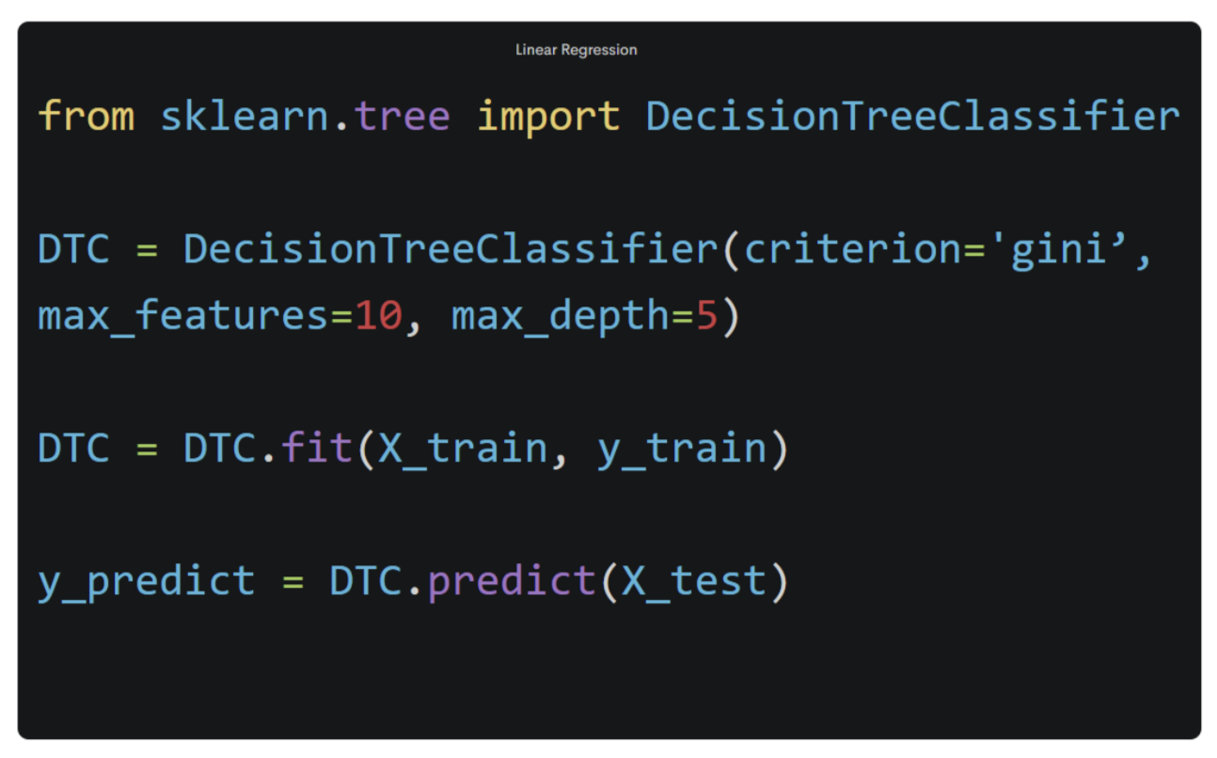
Tools Used In Deep Learning
Python is a general purpose programming language.
As an interpreted and dynamic language, Python mainly supports object-oriented programming approaches and functional programming.
Rapid prototyping
Simple syntax
Easy to use
Large community

Slide 49
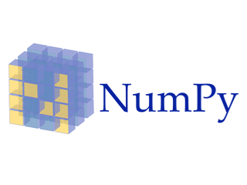
Tools Used In Deep Learning
NumPy is the basic package used for scientific calculations in Python.
Creating an array
Vectorization and slicing
Matrices and simple linear algebra

Slide 50

Tools Used In Deep Learning
Pandas is an open source Python library that facilitates data analysis and data preprocessing.
Useful functions for data manipulation
Tools to read and write data between different formats: CSV and text files, Microsoft Excel, SQL databases
Fast data visualization at a simple level

Slide 51
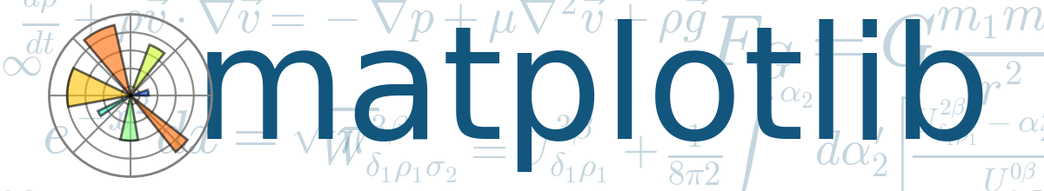
Tools Used In Deep Learning
Matplotlib is a data visualization and plotting library for the Python programming language.
The matplotlib plotting package is one of the most important tools for scientific programming with Python
Can visualize data interactively with
We can produce high quality outputs suitable for printing and publication
Both two-dimensional and three-dimensional graphics can be produced

Slide 52

Tools Used In Deep Learning
Tensorflow is an open source Deep Learning library developed by Google.
Thanks to its flexible structure, it allows the calculations to be deployed using one or more CPUs, GPUs with a single API regardless of platform
This framework, which was developed using Python on its basis, supports many languages such as C++, Java, C#, Javascript and R in addition to Python today

Slide 53

Tools Used In Deep Learning
PyTorch is a Python-based scientific computing package that harnesses the power of graphics processing units developed by Facebook.
PyTorch works with NumPy-like tensor structures for computations, which are GPU compatible
It is pythonic. In this way, you can benefit from the services offered by the Python environment

Slide 54
Deep Learning Resources

Slide 55

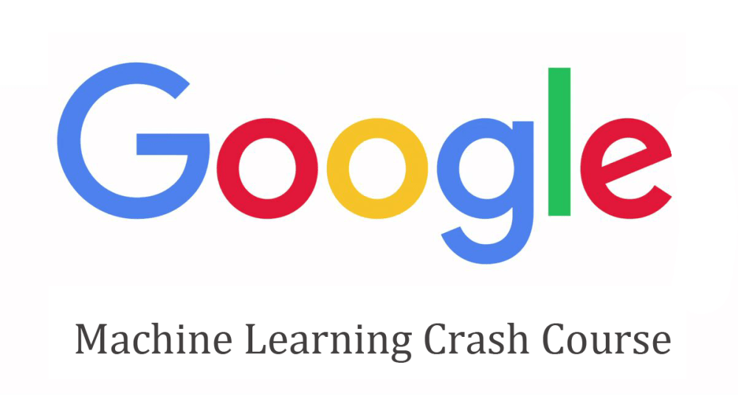
Deep Learning Resources
Global AI Hub
Coursera: Deep Learning Specialization
Deep Learning with Python kitabı (François Chollet, 2017)
Google Machine Learning Crash Course
Kodlama Bilen İnsanlar için Pratik: fast.ai
MIT Introduction to Deep Learning | 6.S191
Deep Learning kitabı (Ian Goodfellow, 2015)

Slide 56
Bonus

Slide 57
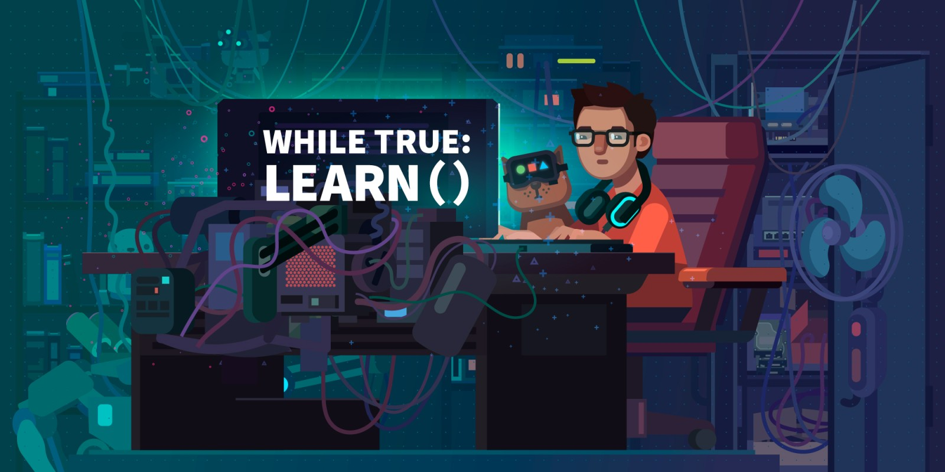
Game Recommendation - While True: learn()
Help a Machine Learning Specialist who can't solve his problem build a cat-to-human translation system that his cat can understand once the problem is solved! Learn about Deep Learning by solving other problems at the same time!

Slide 58
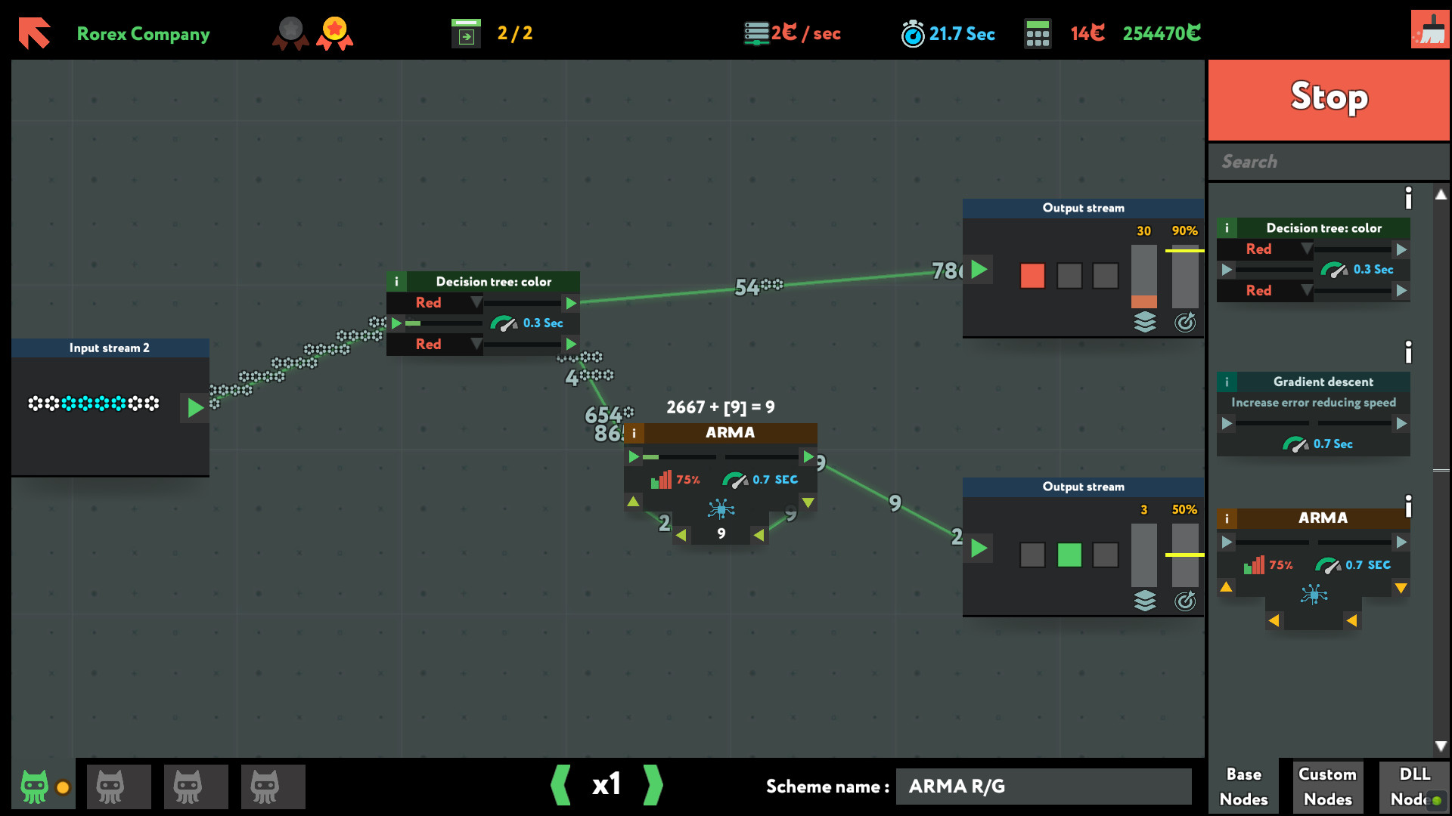
Oyun Önerisi - While True: learn()

Slide 59
Question Time!

